Slide 1
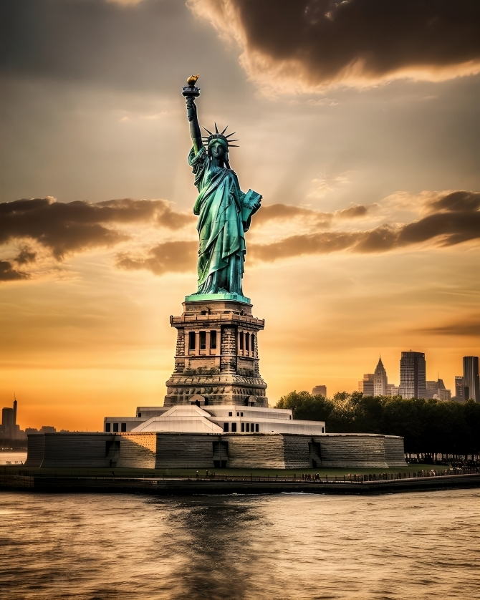
New York City
Housing Prices Predictions
"I would give the greatest sunset in the world for one sight of New York's skyline."

Slide 2
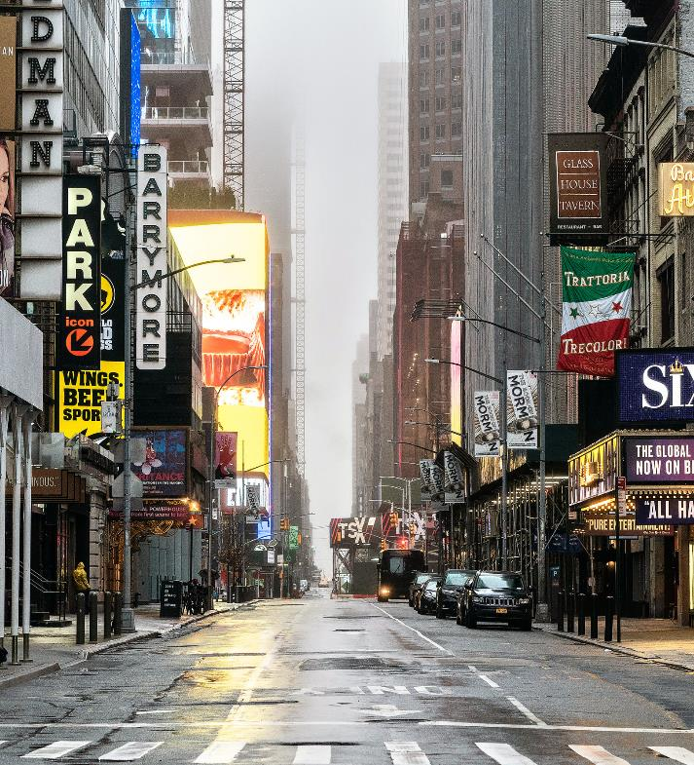
New York City Housing Market
Description
The dataset contains prices of New York City houses, providing valuable insights into the real estate market in the region. It includes information such as house types, prices, number of bedrooms and bathrooms, property square footage, addresses, state, administrative areas, as well as geographical coordinates.

Slide 3
New York City Housing Market
Key Features:
TYPE: type of real estate property
PRICE: Price of the house
BEDS: Number of bedrooms
BATH: Number of bathrooms
PROPERTYSQFT: Square footage of the property
PRICE PER SQFT: Square footage price in the region
PROPERTY CATEGORY: type of the property
BOROUGH: which NYC borough information
LATITUDE: Latitude coordinate of the house
LONGITUDE: Longitude coordinate of the house

Slide 4
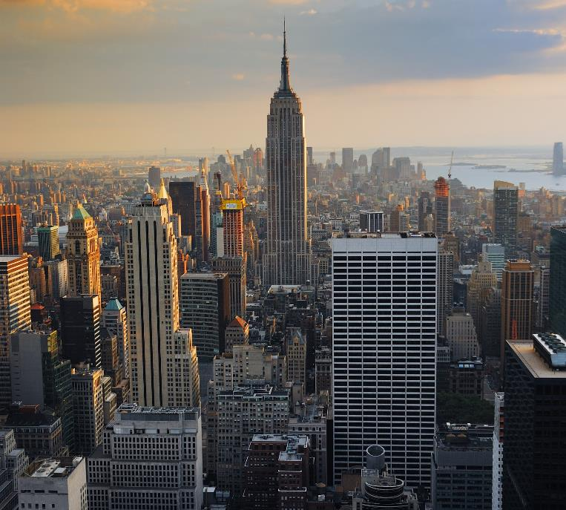
New York City Housing Market
DATA PRE-PROCESSING
DATA SPLIT INTO TRAIN AND TEST SET
OneHotEncoder used for categorical data transform
Standard Scaler used for scaling the numerical columns
FINAL DATASET
print(X_train_final.shape)
print(X_test_final.shape)
(2032, 25)
(678, 25)

Slide 5
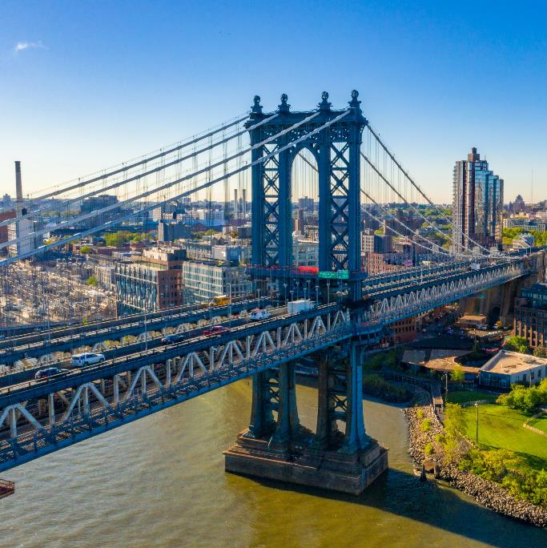
New York City Housing Market
Models to evaluate
Linear Regression: LinearRegression()
Decision Tree: DecisionTreeRegressor()
Random Forest: RandomForestRegressor()
Gradient Boosting: GradientBoostingRegressor()
Support Vector Regressor: SVR()

Slide 6

New York City Housing Market
POTENTIAL USE CASES FOR ANALYSIS
Price analysis: Analyze the distribution of house prices to understand market trends and identify potential investment opportunities.
Property size analysis: Explore the relationship between property square footage and prices to assess the value of different-sized houses.
Location-based analysis: Investigate geographical patterns to identify areas with higher or lower property prices.
Bedroom and bathroom trends: Analyze the impact of the number of bedrooms and bathrooms on house prices.
Broker performance analysis: Evaluate the influence of different brokers on the pricing of houses.

Slide 7
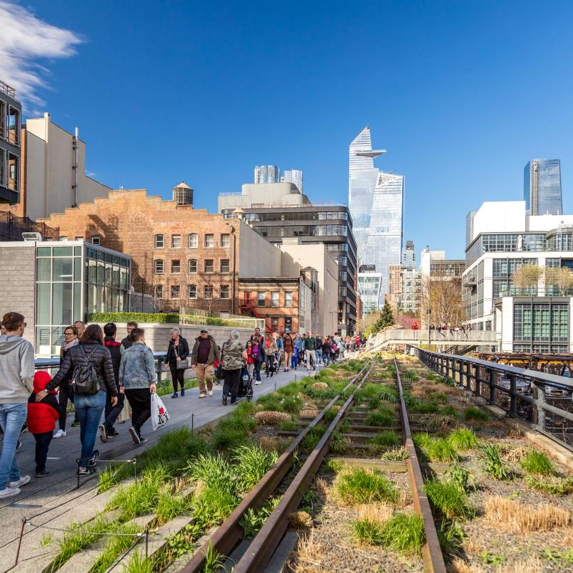
New York City Housing Market
RESULTS COMPARISON
BEST PARAMETERS PER MODEL:
Linear Regression: {'fit_intercept': True}
Linear Regression - MSE: 20109636019.6248, R2: 0.905373
Decision Tree: {'max_depth': 20, 'min_samples_leaf': 1, 'min_samples_split': 5}
Decision Tree - MSE: 3143092659.1132, R2: 0.985210
Random Forest: {'bootstrap': True, 'max_depth': None, 'min_samples_leaf': 1, 'min_samples_split': 2, 'n_estimators': 200}
Random Forest - MSE: 574204422.6805, R2: 0.997298

Slide 8
New York City Housing Market
RESULTS COMPARISON
BEST PARAMETERS PER MODEL:
Gradient Boosting: {'learning_rate': 0.2, 'max_depth': 3, 'n_estimators': 200}
Gradient Boosting - MSE: 600651851.4550, R2: 0.997174
Support Vector Regressor: {'C': 10, 'epsilon': 0.01, 'kernel': 'linear’}
Support Vector Regressor - MSE: 206634421425.1758,
R2: 0.027673
Based on the evaluation, the best model is:
RandomForestRegressor(n_estimators=200)
Random Forest (highest R2 score)

Slide 9
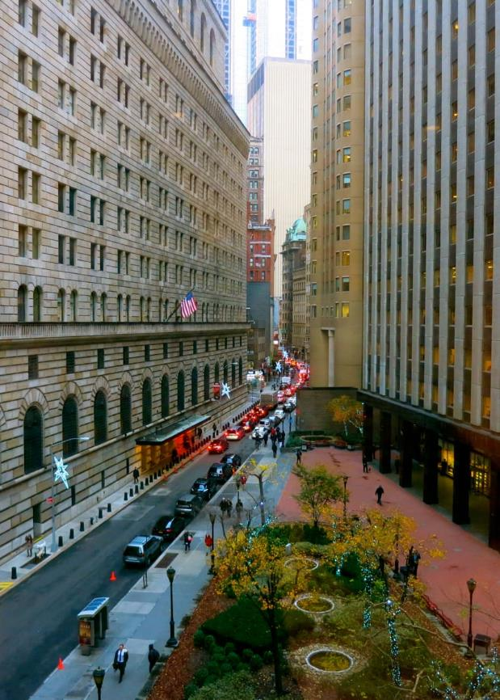
Wall Street
Situated in the Financial District of Lower Manhattan, Wall Street is synonymous with global finance. It is home to the New York Stock Exchange and serves as the hub of the American financial industry.

Slide 10
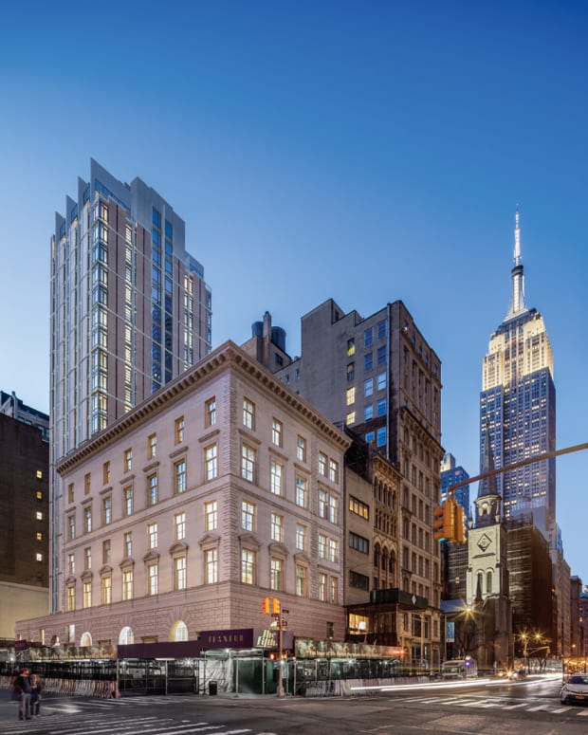
New York City PowerPoint
Fifth Avenue
Known as one of the most prestigious shopping streets in the world, Fifth Avenue stretches through the heart of Manhattan. It features luxury boutiques, flagship stores, and renowned landmarks such as Rockefeller Center.

Slide 11


Located in Brooklyn, Coney Island is a vibrant seaside amusement park and entertainment area. It offers thrilling rides, a beach, boardwalk, and a lively atmosphere with street performers and various attractions.
Coney Island

Slide 12

The Museum of Modern Art (MoMA)
MoMA is a leading institution dedicated to contemporary and modern art. It houses a vast collection of paintings, sculptures, photography, and multimedia installations from renowned artists worldwide.

Slide 13
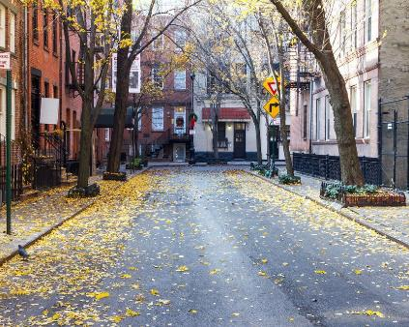
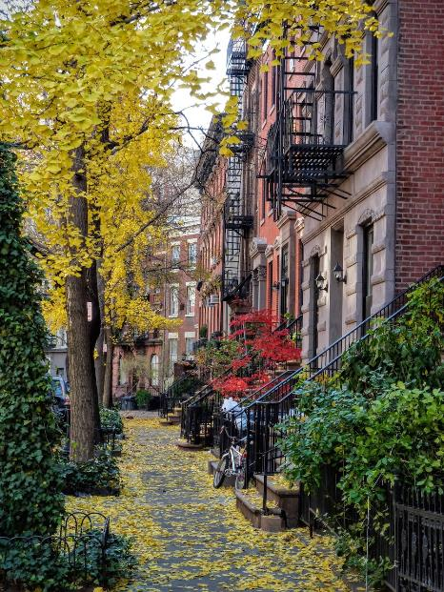
New York City PowerPoint
Greenwich Village
Known for its bohemian and artistic atmosphere, Greenwich Village is a neighborhood in Lower Manhattan. It is famous for its historic townhouses, cafes, jazz clubs, and its association with the Beat Generation and counterculture movements.

Slide 14
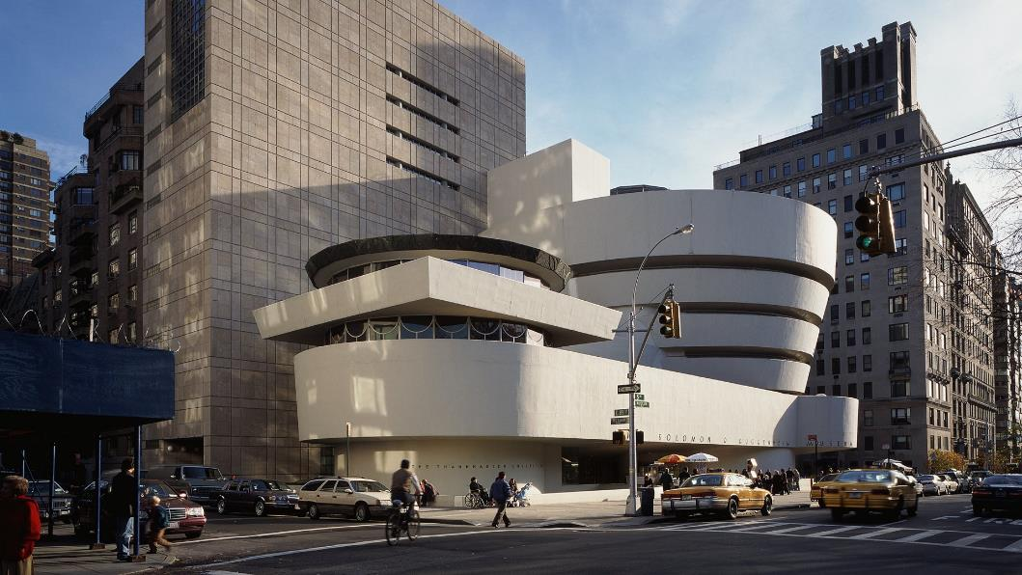
The Guggenheim Museum
Designed by architect Frank Lloyd Wright, the Solomon R. Guggenheim Museum is an architectural masterpiece. It showcases modern and contemporary art in a unique spiraling structure.

Slide 15
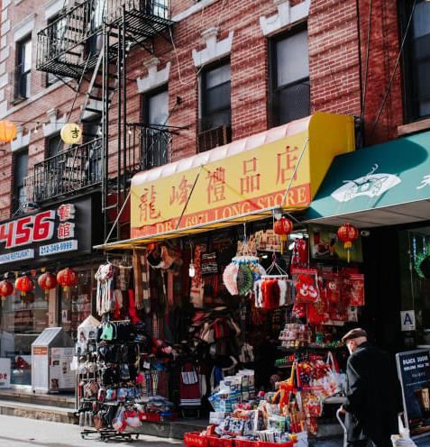
New York City PowerPoint
Chinatown
Located in Lower Manhattan, Chinatown is a vibrant neighborhood filled with colorful shops, markets, and authentic Asian cuisine. It offers a glimpse into Chinese culture and heritage in the heart of the city.

Slide 16
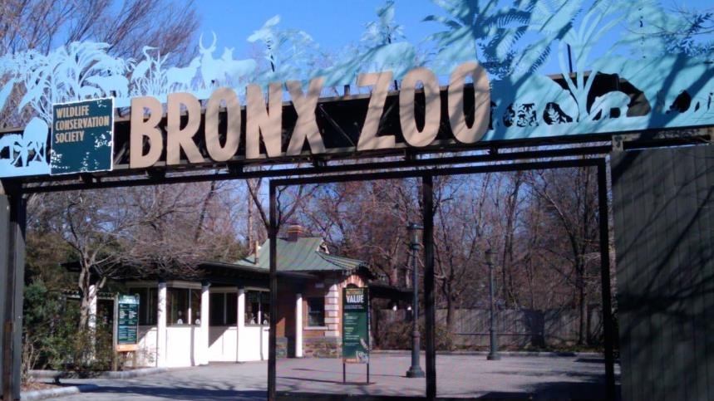

New York City PowerPoint
The Bronx Zoo
As one of the largest metropolitan zoos in the world, the Bronx Zoo houses a diverse range of animals from around the globe. It is a popular attraction for families and animal lovers.

Slide 17
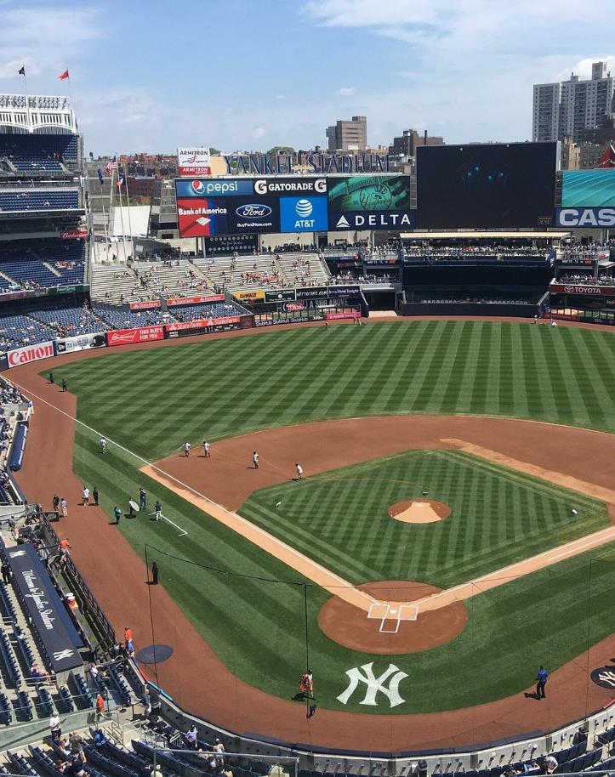
Yankee Stadium
The home of the New York Yankees baseball team, Yankee Stadium is a legendary sports venue in the Bronx. It has a rich history and is a must-visit for sports enthusiasts.

Slide 18
Icons

Slide 19
Icons

Slide 20
How To Edit Shapes
You can add and edit some shapes to your presentation to present your data in a visual way.
Choose your favourite infographic and insert it in your presentation using Ctrl C + Ctrl V or Cmd C + Cmd V in Mac.
Select one of the parts and ungroup it by right-clicking and choosing “Ungroup”.
Change the color by clicking on the paint bucket.
Then resize the element by clicking and dragging one of the square-shaped points of its bounding box (the cursor should look like a double-headed arrow). Remember to hold Shift while dragging to keep the proportions.
Group the elements again by selecting them, right-clicking and choosing “Group”.
Repeat the steps above with the other parts and when you’re done editing, copy the end result and paste it into your presentation.
Remember to choose the “Keep source formatting” option so that it keeps the design. For more info, please visit Slideegg (Tips & Tricks).

Slide 21
Terms Of Use (Free Users)
If you are a free subscriber, you should credit SlideEgg by keeping the “Thank You” slide.
Kindly refer to the following slide for the Terms of Use for premium users.
You can:
Customize or edit this template
Use this template for both business and personal endeavors.
You can not:
Sell, rent, or second-license SlideEgg content or its altered version. Promulgate, unless explicitly permitted, SlideEgg content, by SlideEgg.
Incorporate SlideEgg content in any database or file online or offline.
Obtain SlideEgg content’s copyright.
Kindly refer to our Tutorial page or FAQ for advanced slide modification guidelines.

Slide 22
Terms Of Use (Premium Users)
Being a premium subscriber, you have the privilege of using this PPT template
without giving attribution to SlideEgg or keeping the “Thank You” slide.
You can:
Customize or edit this template.
Use this template for both business and personal endeavors.
Circulate or share the editable format of this template with anyone you want.
You can not:
Sell, rent or second-license SlideEgg content or the altered version of it. Promulgate or include the templates in any other services database
that performs as distribution or resale platform, unless explicitly permitted, by SlideEgg.
Incorporate the elements used in SlideEgg’s templates separately.
Obtain SlideEgg’s copyright for the elements used in this template as a logo or trademark.
Kindly refer to our Tutorial page or FAQ for advanced slide modification guidelines.

Slide 23





Thank You!
We respect your valuable time with SlideEgg!
If you have any questions, please reach us
Do you have a design request, please visit our redesign page.
CREDIT: SlideEgg created this PowerPoint template.
Let this slide be kept for attribution.
www.slideegg.com

